Slide 1
Digital Privacy in libraries as Digital Literacy
James Henry Smith
Information Literacy Librarian for Online Learning
Indiana University Bloomington

Slide 2
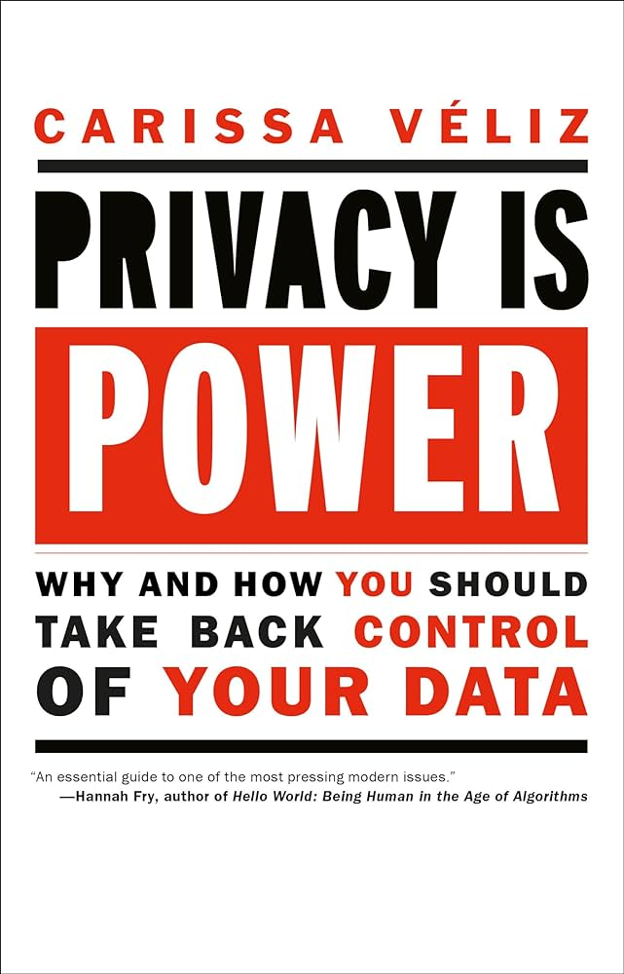
Serendipitous beginnings
Walking through the stacks at Monroe County Public Library and this book caught my eye on the shelf, checked it out then got it on Libby for an upcoming long drive.
Realized while driving and listening, I was giving away
Location data
Google maps destination
Email
Phone number
All data associated with my google, libby, and Apple account usage

Slide 3
Today’s Session
Why should we as librarians care about this?
Three case studies
Online
Public
Academic
Future directions and potential implications

Slide 4
Privacy in Libraries: Why should we care?
Article VII of the American Library Association’s Library Bill of Rights:
“All people, regardless of origin, age, background, or views, possess a right to privacy and confidentiality in their library use. Libraries should advocate for, educate about, and protect people’s privacy, safeguarding all library use data, including personally identifiable information.”

Slide 5
Digital Privacy as Digital Literacy
A few key terms to define
Data exhaust
Cookies
Data brokers

Slide 6
Before diving into the examples, remember
https://www.termsandconditions.game/
Take a few minutes to play this game drop in the chat what your score was

Slide 7
Digital Privacy LibGuide
Offering reading lists and tools to explore

Slide 8
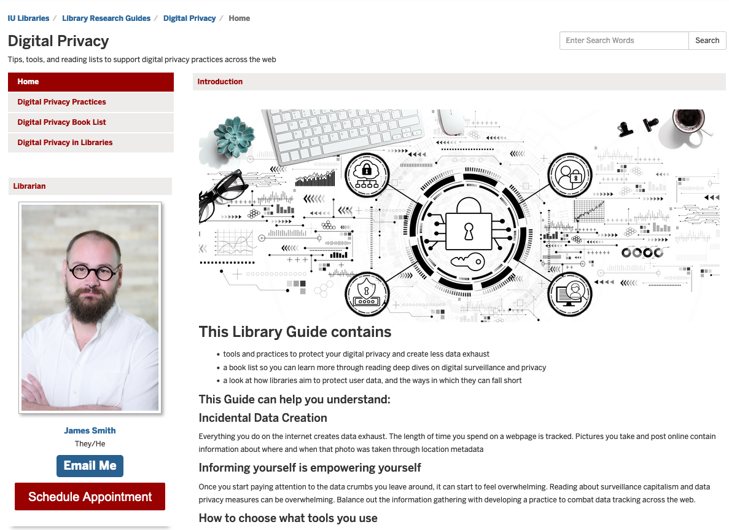
https://guides.libraries.indiana.edu/digitalprivacy

Slide 9
Digital Privacy in Public Libraries
A collaborative program at Monroe County Public Library

Slide 10
“Control Your Smartphone Data” James Henry Smith, Indiana University Libraries Jack Kovaleski, Monroe County Public Library
Time | Agenda | Description
(5 min) | Welcome! | Welcome, Introductions, and About the Workshop including roadmap/outline of program
(10 min) | Opening activity | Ice Breaker activity: When is privacy important to you? What measures do you take to ensure your privacy? How do you protect others' privacy?
(20-25 minutes) | Presentation and App Audit | Introduction to Digital Privacy and program outline What is digital privacy? Why is it important? What are digital breadcrumbs? How are they created? Control Your Smartphone Data handout and walkthrough What data is being collected by the apps you use? What are practical steps you can take to control your phone’s data footprint? Activity: Clear Location Footprints Tidy Up Your Apps
(10-15 min) | Q&A | Participant Q&A and follow up discussion
(5 min) | Resources for further Learning and Collaboration | MCPL Resource Page Fill out a program survey
(5 min) | Closing + Thank you! | Thank you!
Largely based off of the Privacy Section of the Data Detox Kit, using activities 2 and 3 from the Control your smartphone data to increase your online privacy handout
The Data Detox Kit has several workshop outlines to use as well as handouts like the one used in this.
Published under a CC-BY-NC-ND license, so the handouts can be used as is.

Slide 11
Digital Privacy in Academic Libraries
Same messaging to a different audience

Slide 12
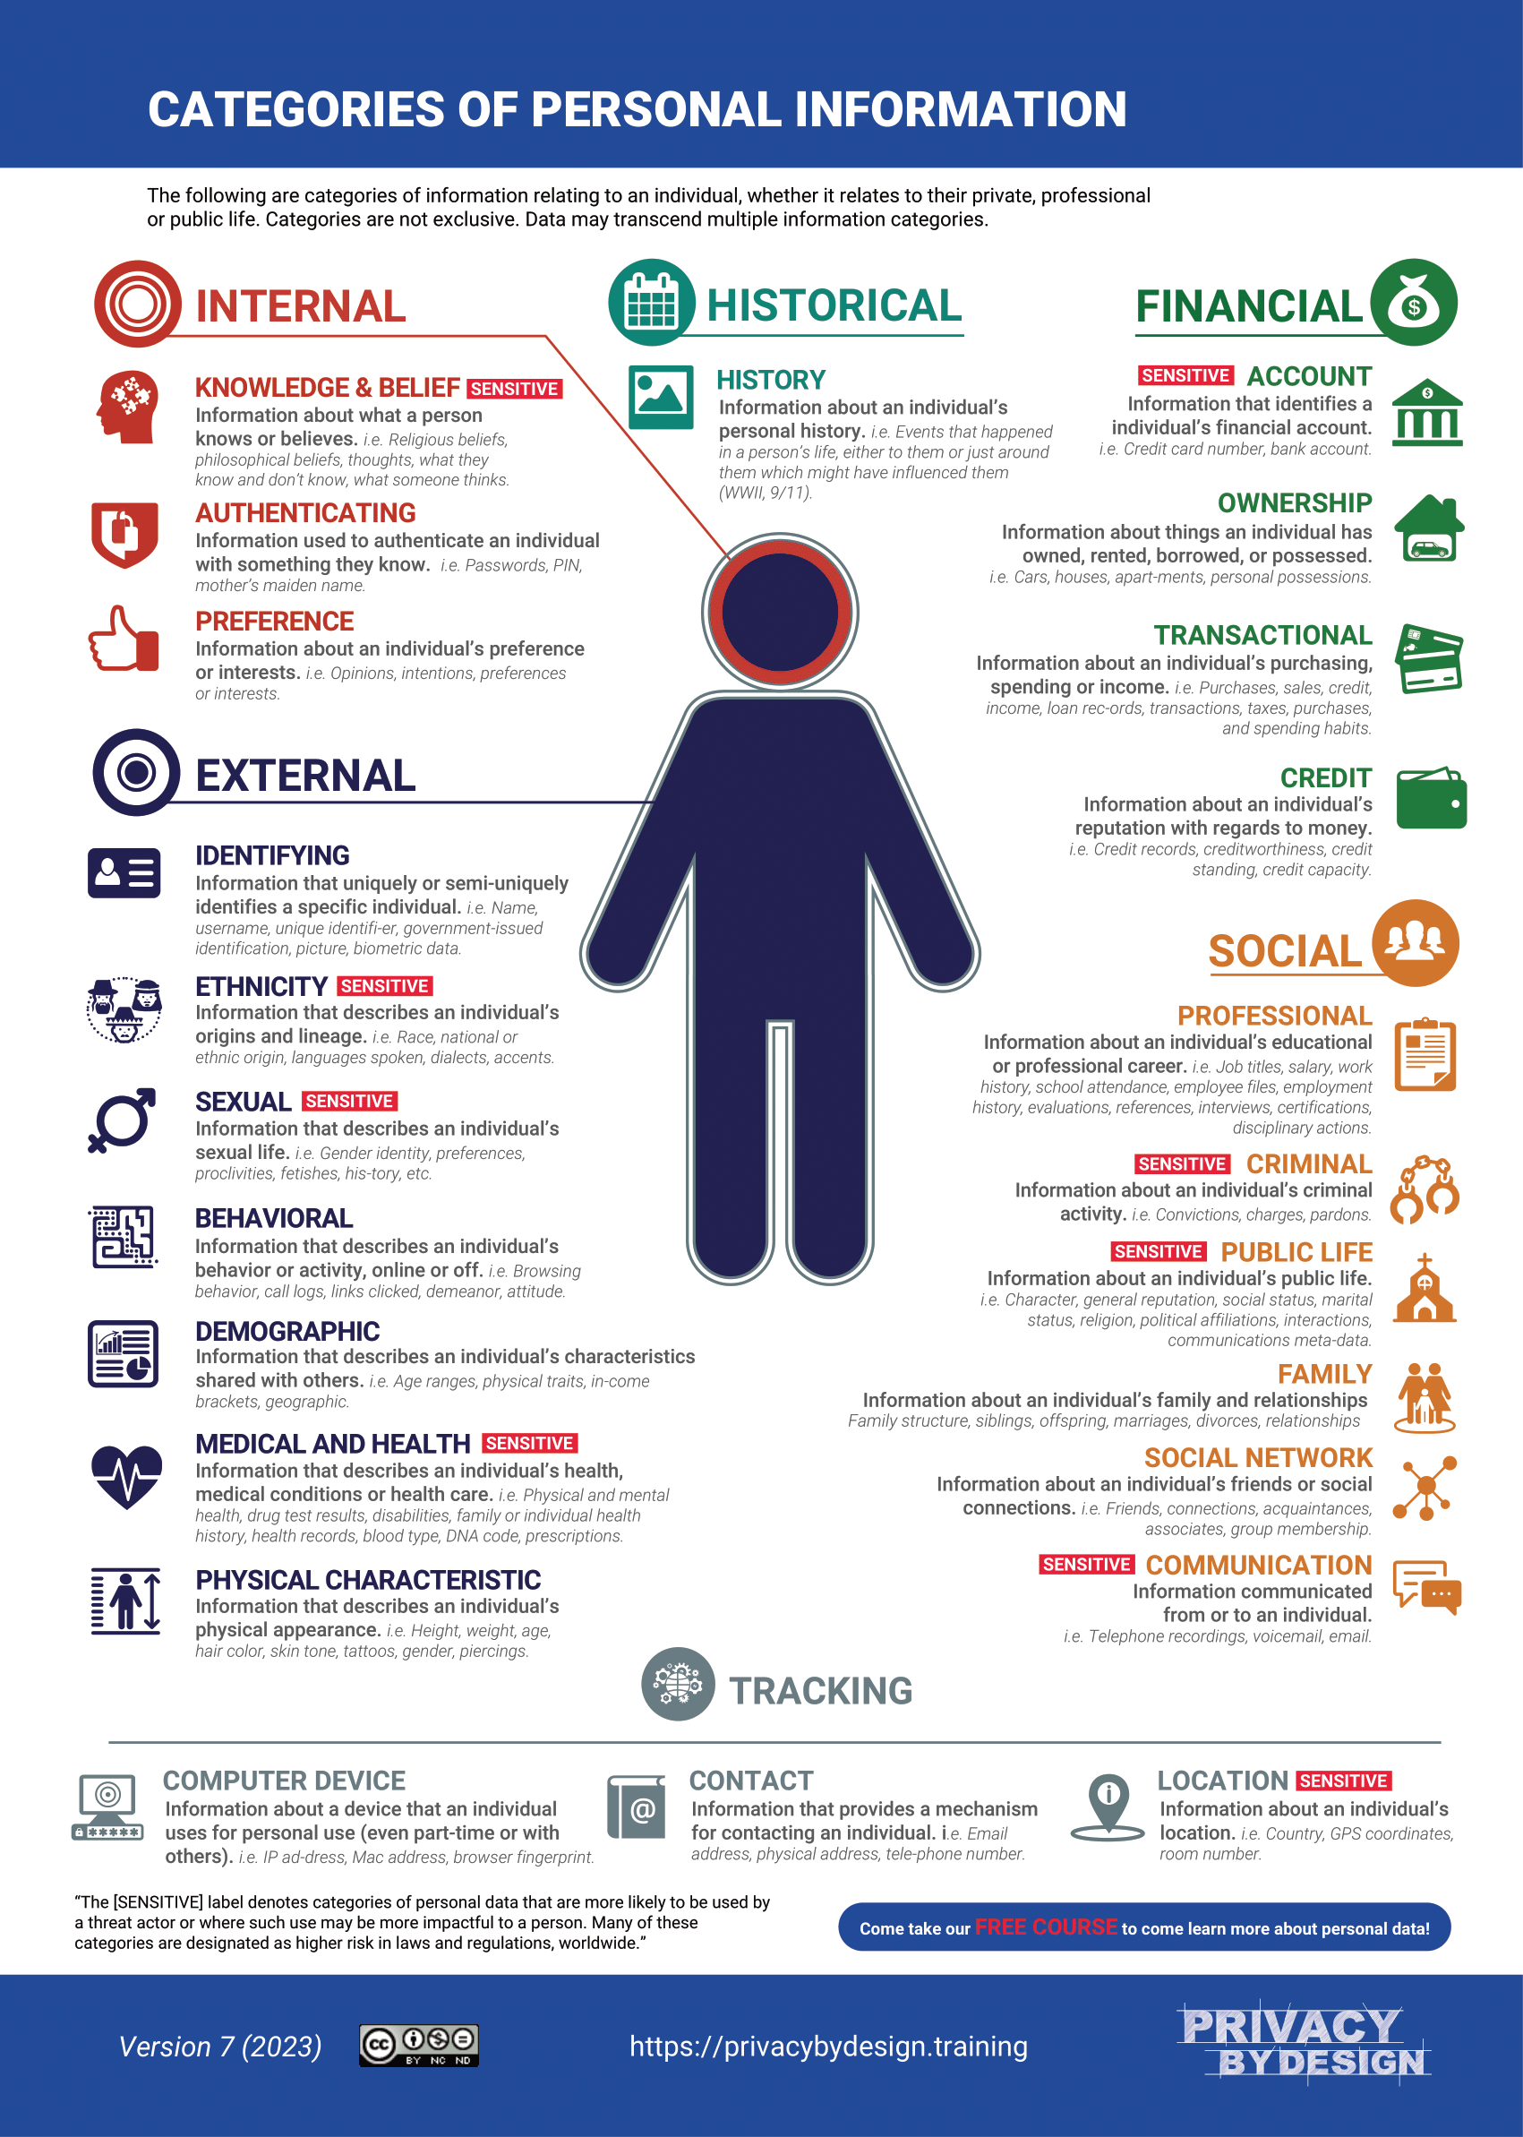
Ece Gumusel, Privacy Analyst at UIUC and PhD Candidate in Information Science IUB
Session outline:
Terms and conditions game
Categories of personal information
Where does privacy matter to you?
App audit and change privacy settings

Slide 13
Future Directions
Why and how to continue this work

Slide 14
Knowledge is Power, Privacy is Power
Three ways to do this at your library:
Passive programming
Active workshops
1:1 interactions

Slide 15
Thank you!
George Bergstrom, Indiana State Library
Jack Kovaleski, Monroe County Public Library
Ece Gumusel, Univeristy Illinois Urbana-Champaign
and IU Bloomington
Indiana University Libraries

